Slide 1
Week 4

Slide 2
Borderline
Personality
Disorder

Slide 3
BORDERLINE DISORDERS:
PHARMACOLOGIC SUBTYPES
SCHIZOTYPAL
AFFECTIVE INSTABILITY
REJECTION SENSITIVITY
ANGRY/IMPLUSIVE

Slide 4
AVOID
BENZODIAZEPINES
WITH BORDERLINE
DISORDERS!

Slide 5
Treatment
Implications
SSRIs

Slide 6
SSRIs
Modest treatment effects
Mainly reducing:
> irritability
> impulsivity

Slide 7
Benzos and Borderline
“Favorite drug”
Often abused
Chronic use associated with
increased suicide attempts
and self-mutilation

Slide 8
BPD: Meta Analysis
Ingenhoven, et al, 2009
Journal of Clinical Psychiatry: on-line
21 trials
Antipsychotics:
> improved suspiciousness and anger
> No impact on depression or
impulsivity
Abilify: best; Zyprexa: little effect

Slide 9
BPD: Meta Analysis
Ingenhoven, et al, 2009
Journal of Clinical Psychiatry: on-line
Antidepressants:
> positive impact on impulsivity
and anger
> little impact on depression
Mood stabilizers: best results:
robust responses # of symptoms

Slide 10
Sleep Disturbances

Slide 11
Insomnias of Anxiety and Depression
∞
Hypersomnia
(15%)
* Bipolar II

Slide 12
Sleep Efficiency

Slide 13
Slow wave sleep
Restorative (deep) sleep
Immune functioning
Release of growth hormone
Deprivation:
> Fatigue
> Cognitive problems
> Affect regulation

Slide 14
Enhancing slow wave sleep
Regular exercise
Sleep cool
Melatonin
Avoid substances that
interfere with slow wave sleep

Slide 15
Sleep Disturbances
Alcohol
Benzodiazepines →
Caffeine

Slide 16
Benzodiazepines
Minor tranquilizers
Most prescription sleeping pills
Decreased time in slow wave sleep

Slide 17
Sleeping Pills
Minimal Impact on sleep stages
> Sonata
> Ambien
> Lunesta
No impact on sleep stages
> Rozerem

Slide 18
Non-habit forming
Alternatives
Trazodone 25-75 mg
Silenar 3-6 mg
Remeron 7.5-15 mg
Tricyclics (pain: Elavil, Nortiyptyline)
Seroquel: 100-200 mg
(increase slow wave sleep)
Benadryl 25-50 mg
Belsomra 15-40 mg (?)

Slide 19
Belsomra:
Suvorexant:
orexin antagonist
10-40 mg dose
Turns off wakefulness rather
than inducing sleep
NEW

Slide 20
Belsomra
Benefits:
> non-habit forming ????
> not a central nervous system
depressant
> better at maintaining sleep than
traditional sleeping pills

Slide 21
Melatonin
High doses: depression
(more than 1 mg)
Unsafe in children (except…)
Low dose strategy: 0.5 mg
1/2 hour before bedtime

Slide 22
Blue Blocking Lenses
Most cheap, on-line amber:
block only 10%
need to block 90%
SKYPER SCT orange lens
#S1933X Amazon.com

Slide 23
Caution
High Dose
Melatonin can increase depression and may be unsafe for children
National Institutions of Health

Slide 24
Sleep Disturbances
Benzodiazepines
Alcohol
Caffeine

Slide 25
Chronic Pain
Impact on sleep
Dual action antidepressants:
tricyclics: Elavil, Doxepin
Effexor; Cymbalta

Slide 26
Primary Sleep Disorders
Restless Legs: 10% prevalence
* 40% depression (AD side effects:10-15%)
Obstructive Sleep Apnea
* 24% of men
* 9-13% of women
* 45% have depressive Symptoms
* Often: no response to
Antidepressants
obstructive →

Slide 27
Restless Legs
(Periodic leg movements: PLM)
As a primary disorder
10% prevalence; 40%: depression
Due to antidepressants: 15%
significantly more common:
antidepressants
other than Wellbutrin
Serotonin: Dopamine blocking

Slide 28
Primary Sleep Disorders
Restless legs: 10%+
more common in elderly
solutions
> decrease caffeine

Slide 29
Other Sources of Sleep Problems
Restless legs
> iron supplement (if deficient)
> magnesium supplement
> ↑ potassium & B vitamins
> prescription drugs →

Slide 30
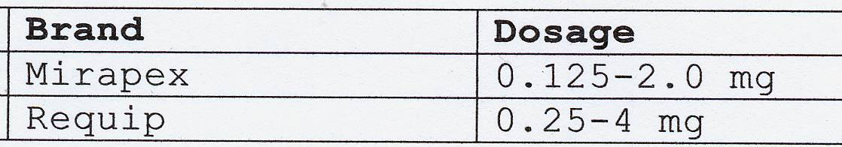
Prescription Meds for Restless Legs
Adult doses

Slide 31
Signs and Symptoms: Apnea
Day time fatigue
Snoring
Obesity
Depression
Affect dysregulation

Slide 32
CPAP: Continuous Positive
Airway Pressure

Slide 33
Fleas and Tics

Slide 34
The “Usual Suspects”
Drugs: alcohol, some high blood
pressure meds, tranquilizers,
steroids, female sex hormones,
high levels: caffeine

Slide 35
The “Usual Suspects”
Medical Illnesses/conditions:
primary sleep disorders, thyroid
disease, hormonal changes
associated with reproduction
(PMS, post-partum, menopause),
chronic pain; some neurological
conditions (e.g. TBI / concussion)

Slide 36
Many Unsuspected Medical Conditions can Intensify Suffering

